Slide 1

Netflix Dashboard Created by : Yash Gode
Project link : https://public.tableau.com/views/NetflixMovies_16706572434760/NetflixDashboard?:language=en-US&:display_count=n&:origin=viz_share_link

Slide 2
LIST OF KPI’s
Total Movies and Tv Shows By Year
Top 10 Genre
Total Movies and Tv Shows By Country
Ratings
Movies and Tv Shows Distribution

Slide 3
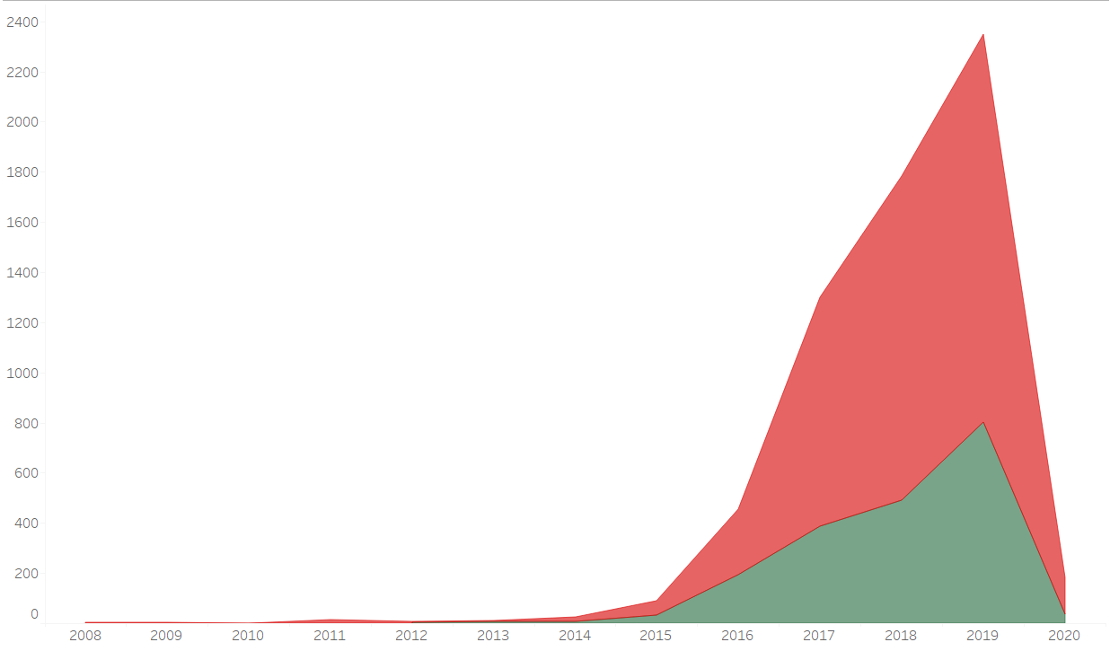
Total Movies and Tv Shows By Year
The above graph shows year wise total tv shows and movies.
In year 2019 there is maximum movies and tv shows.

Slide 4
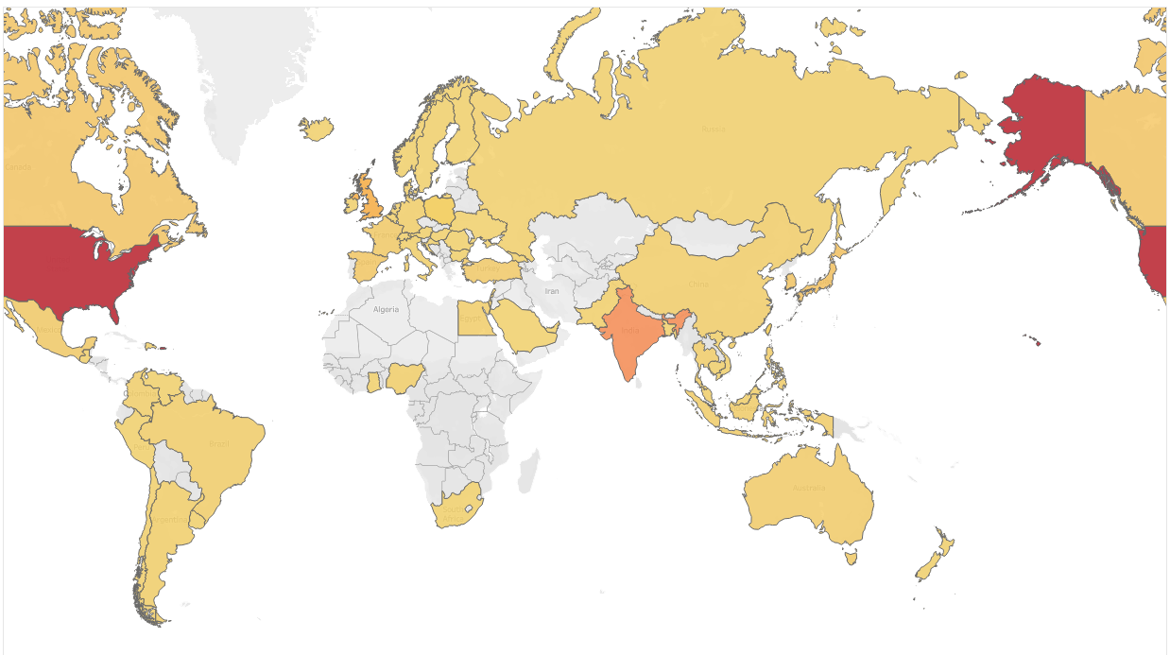
Total Movies and Tv Shows By Country
The above filled map shows total movies and tv shows by country wise.
In region filled in red color is having maximum movies and tv shows which Is United States.

Slide 5
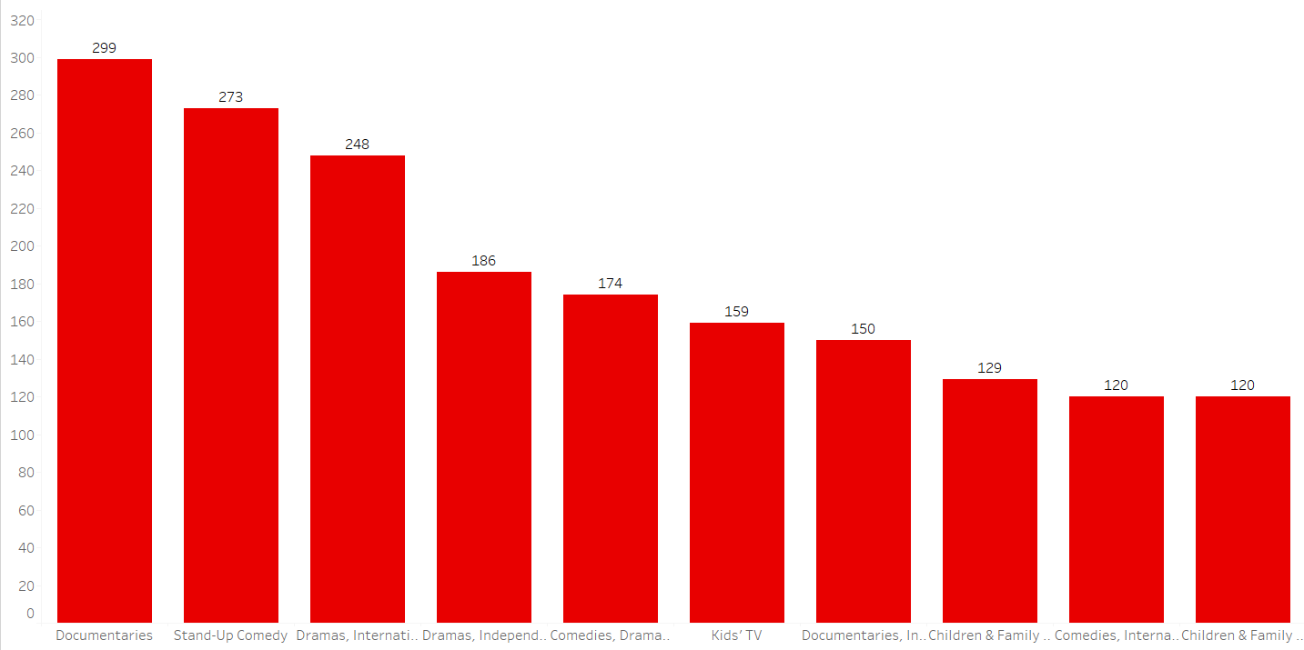
Top 10 Genres
The above bar graph shows top 10 genres.
There is maximum shows on Documentaries.

Slide 6
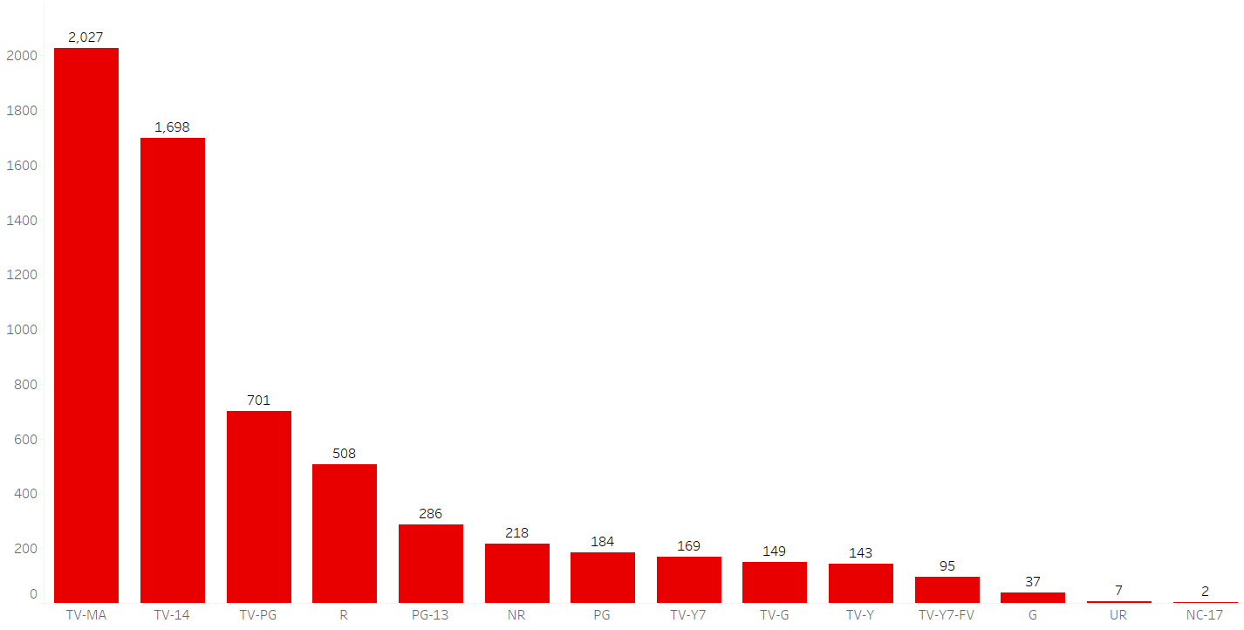
Rating
The above show wise ratings.
TV-MA is having the maximum rating.

Slide 7
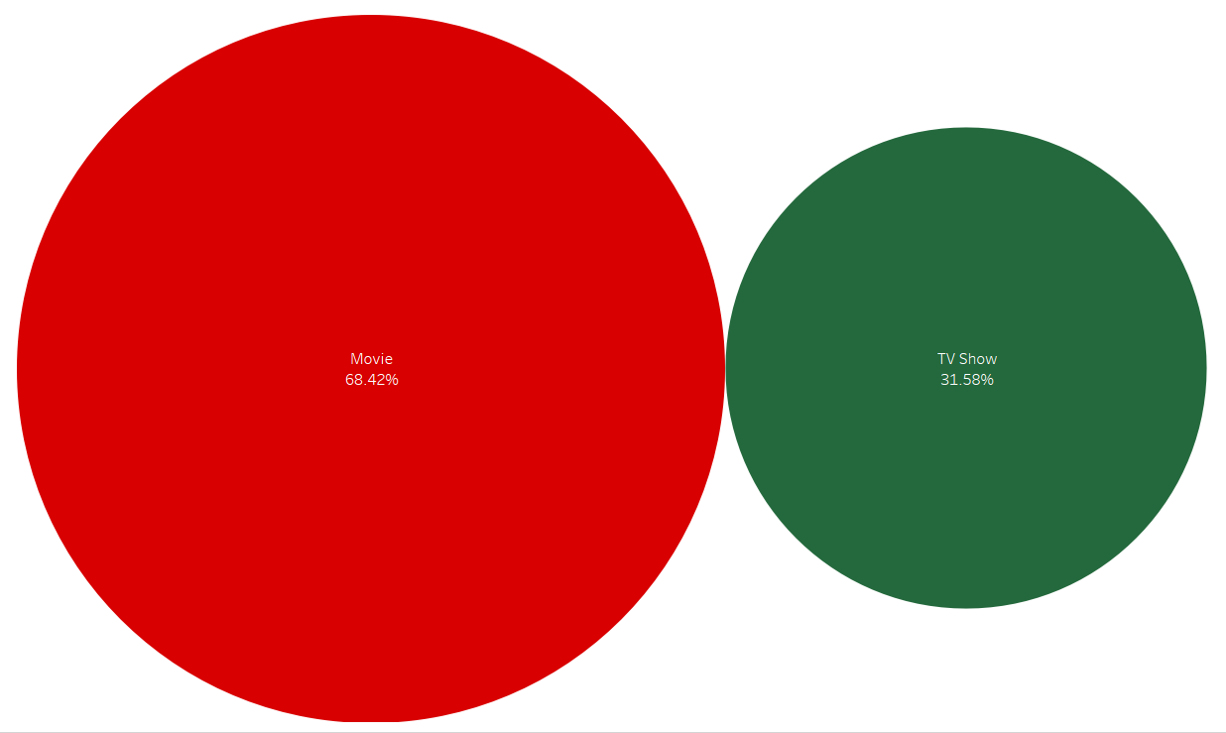
Movies and Tv Shows Distribution
The above packed bubbles graph show the ratio of movies is 68.42% which is maximum as compared to Tv shows.

Slide 8
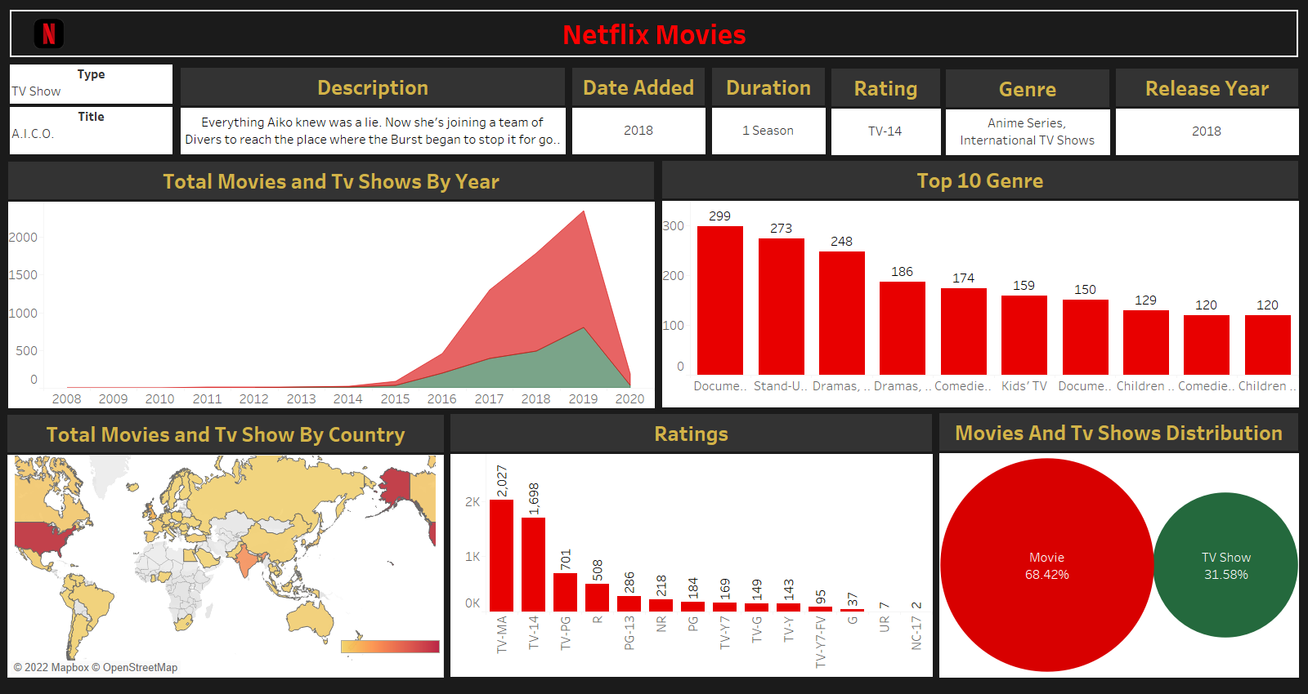
Netflix Dashboard

Slide 9


